Slide 1
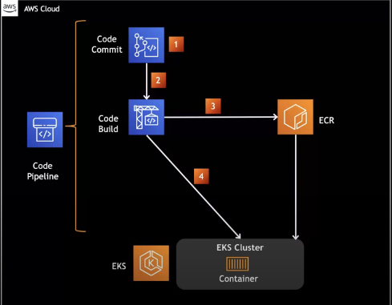

Slide 2
Code commit - Developers commit and push the code to a particular branch.
Pipeline will trigger and send the artifact to Code build.
Code build will create a docker image and push to ECR.
Once it is pushed, we perform the deployment using kubectl commands.

Slide 3
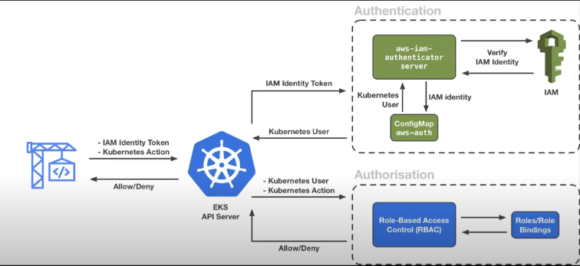
AWS IAM authentication server:
I have to get a new token each time and keep it.
Code Build send the token with K8s action. It will go to IAM ID token and check whether user exists or not.
After that, it will check with the config map whether the user is authenticated to authenticate with the API server.
Once authentication is done, it will check whether the user has the permission to do the deployment or not.

Slide 4
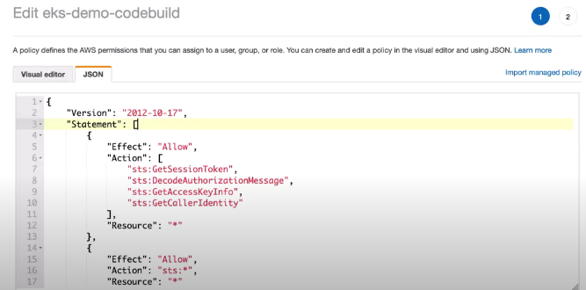
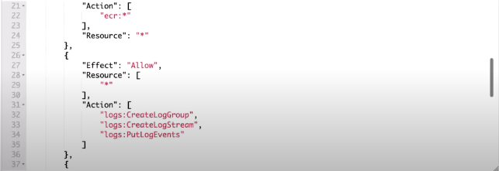

Slide 5
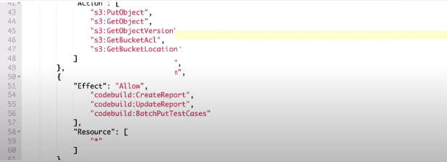

Slide 6
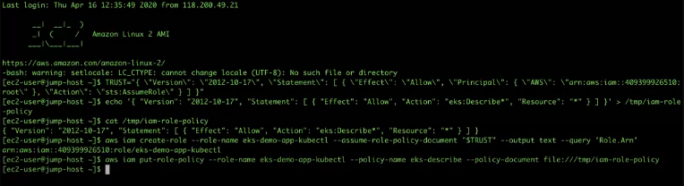

Slide 7
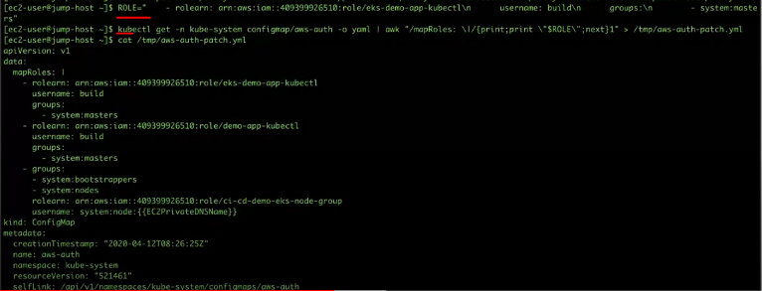
Need to add in Environment variables

Slide 9
